Slide 1
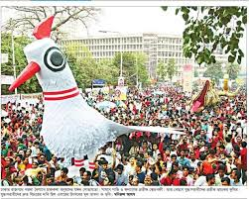
Welcome

Slide 2
Mahmuda khatun.
Assistant Teacher.
:Jasodal High School.
Kishoregonj.
Sub : English.
Class: nine
Date:

Slide 3
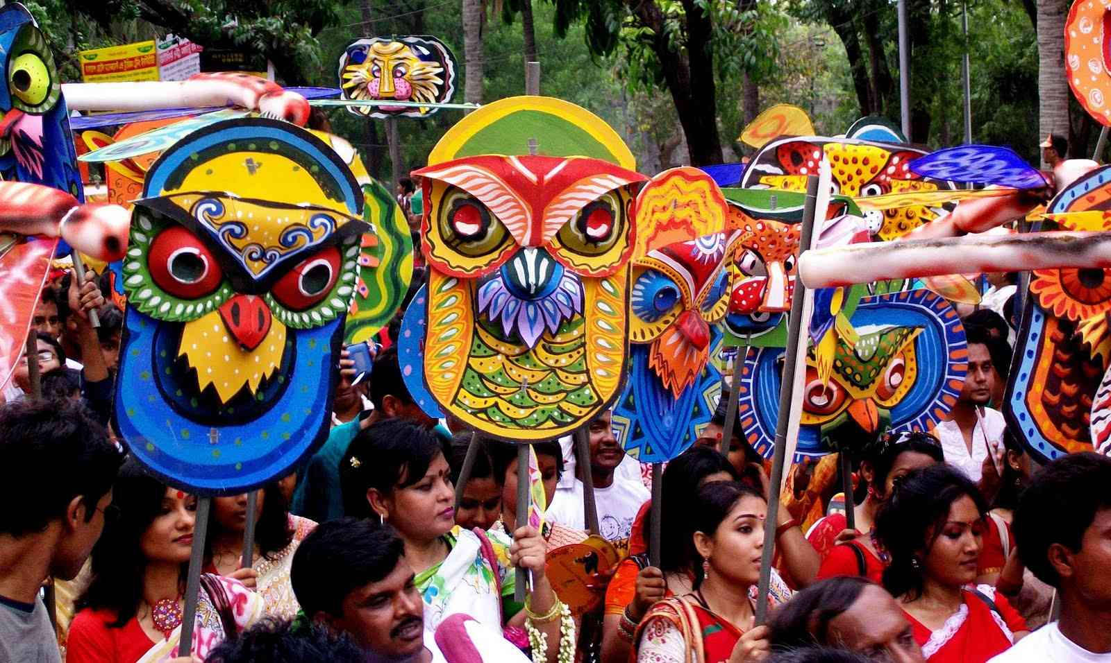

Slide 4
Pahela Boishakh

Slide 5
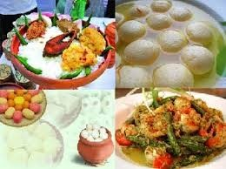
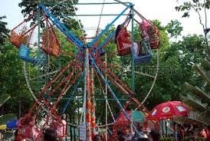
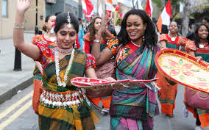

Slide 6
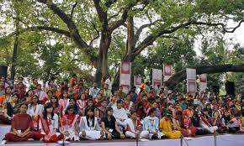

Slide 7
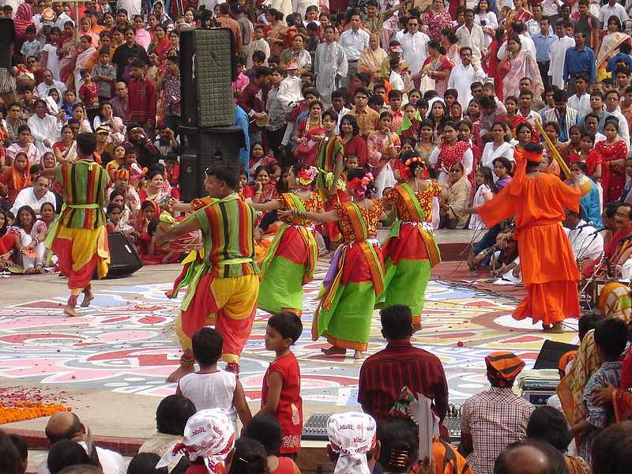
Video c/org;

Slide 8
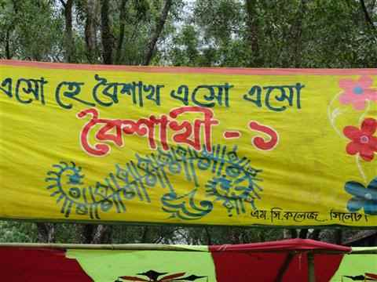

Slide 9
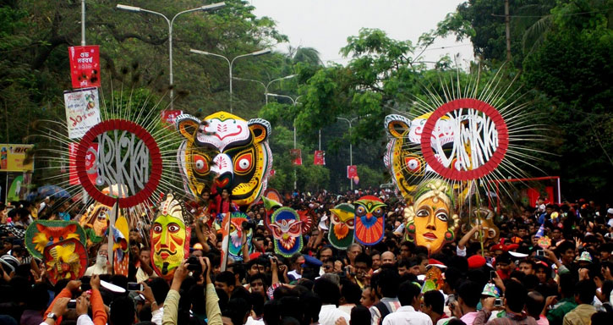

Slide 10
Individul work
Write down the name of cultural organisations name.

Slide 11
Group work
Write to about your feelings on Pahela Baishakh .

Slide 12
Word meaning
Organised= make a united
Culture =roles of socil
Instrument= tools
Tradition = aged/back dated

Slide 13
Evaluation
What is the Pahela Baishakh?
Are you going to Baishakhi mela?
Is it a holiday?

Slide 14
Home work
      Write a short article about a fair.

Slide 15
Thank You

